Slide 1
GFTL PS - Set up for handling Product Security Regulations
GFTL PS Frameworks

Slide 2


Scope – Handling Product Security Regulations
The scope is “direct and indirect regulations and frameworks/standards of relevance to Product Security.”
Regulation is defined as “a rule or directive made and maintained by an authority”.
Product Security regulations can either be
Direct towards Ericsson products, for instance the proposal for EU Cyber Resilience Act.
Indirect through our customers and their use of Ericsson products, for instance the UK TSR/CoP.
In the field of indirect regulations, one has to draw a line on what to cover and not.
We exclude secrecy acts, national security acts, acts on object with special protection, which has impact on topics like what information you can get in an RFX, but it is assumed to be covered by Ericsson legal entity level.
We exclude any other product related regulation already covered by Ericsson, for instance environmental.

Slide 3
Scope – Further clarification
Legislation is defined as “the process of making or enacting laws” and is in our wording included in regulations.
Security standards are for instance 3GPP, which becomes a standard through ETSI, ISO27001(Information Security) and IEC 62443(Operational Technology Security). Standards are formed within relevant stakeholder groups and agreed upon a recognized bodies.
Security frameworks are industry best practices that provide documented policies, controls, processes, procedures. It could be company specific like Ericsson’s SRM, or organizational specific like ISACAs COBIT, or governmental like NIST CSF and NIST SSDF.
Security control library is for instance NIST 800-53, but then also ISO27002 is a security control library.
Ericsson Internal controls are for instance Generic Product Requirements(GPR) with corresponding Design Rules(DR) for product security and privacy.

Slide 4
A structured approach – Stakeholders involved
Ericsson has the distributed resources throughout the organization to learn about new regulation with relevance to product security, for instance
  Government and Policy Advocacy(GPA)
  MA Solution Security
  GFTL PS Customer Security Directors located in the MA
Ericsson has the centralized resources to work with it from a requirement perspective and driving the strategic work.
  BA
  GFTL PS
Those out in the field have good position to provide insights to the center.
BA and GFTL in the center drives the strategic agenda, while GPA both act in the field and center.

Slide 5
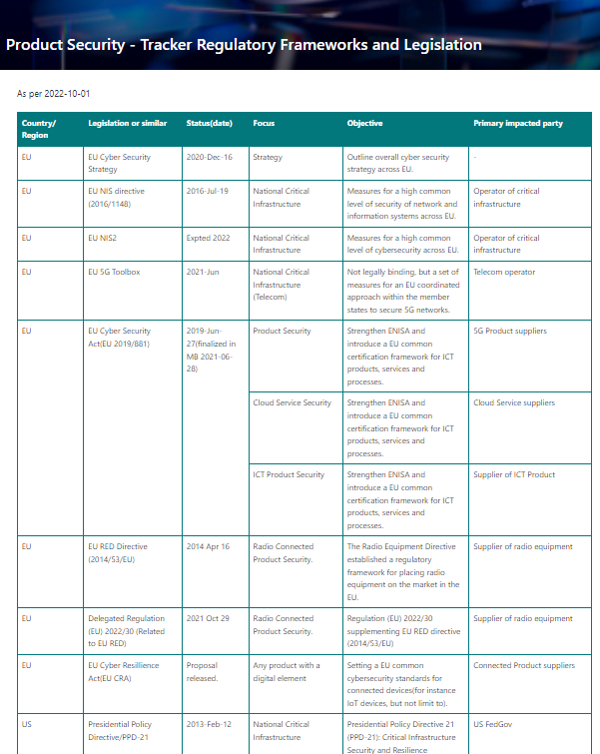
A structured approach – Global set up
MA Americas
MA EMEA
MA South East Asia Oceania & India
MA North East Asia
US/Canda meeting on PS Regulation
Latin America meeting on PS Regulation
MA “tracker” PS Regulations
EU/EFTA meeting on PS Regulation
MEA meeting on PS Regulation
MA “tracker” PS Regulations
South East Asia Oceania & India meeting on PS Regulation
MA “tracker” PS Regulations
North East Asia meeting on PS Regulation
MA “tracker” PS Regulations
Presenting on GFTL PS site which regulation (with relevance for product security) we consider.
Product Security Regulatory Core Team meeting
Global tracker on PS Regulation
Regulation deemed of high interest, for instance EO14028, EU CRA, UK TSA/CoP etc.
Separate project/TEAMS site. Result also stored in regional and global Product Security Regulation TEAMS site.
Regulation deemed of interest or needs a first evaluation.
Utilizing regional Product Security Regulation TEAMS site for smaller project. Export result to global tracker on Product Security Regulation.
Regulation deemed of less importance or in waiting mode.
Store basic information on regional Product Security Regulation TEAMS. Export result to global tracker on Product Security Regulation.

Slide 6
Summary
The scope is “direct and indirect regulations and frameworks/standards of relevance to Product Security.”
GFTL PS website provides insight on which regulations that are being considered. Aim is to provide trust within Ericsson, avoid duplication of work within Ericsson, but also provide possibility to raise questions on regulations of relevance to Product Security.
The setup is in line with applicable steering document in EGMS.
The setup provide regional level information sharing capability and reusability of earlier conducted work.
The set up provide group level visibility and possibility to prioritize work in evaluating new regulations of relevance to Product Security.

Slide 8
Charter –Product Security Regulation Regional fora
Chairperson
Patrik Palm Head of Product Security - Frameworks
Driver
Bo Fjelkner Sr PS Frameworks Manager
Secretary
Bo Fjelkner Sr PS Framework Manager
Participants
Head of Solution Security in the region (or person appointed by)
GFTL PS Customer Security Directors in the region
GPA representatives in the region
Regional Head of Enterprise Security (or person appointed by)
GFTL PS managers
Purpose
Identify Product Security Regulations related to the region. Product Security Regulations in scope can be in initial phase, development and approved and under implementation.
Identify Product Security Regulation of particular interest for which it would make sense to further evaluate, either in a separate project, or smaller cases, by individuals.
Sharing experience from other regions that might have impact on Product Security Regulations in the region.
Frequency: Monthly, excluding vacation periods
Scope and Deliverables
Identify all regional product security regulations from its initiation, development to approval and implementation.
Identify which of the regional product security regulations that need further attention. (Evaluation of product security regulation is not necessarily handled within this fora.)
Regulations of great importance to Ericsson should be brought forward to management within MA, GPA and GFTL PS. After decision, a project could be established to review and evaluate impact.
Regulations of lesser importance to Ericsson could be reviewed by someone within this fora or other available recourse within the MA.
Monthly updating the regional Product Security tracker and update on the different regional projects. This include including brief updates from ongoing projects.
Share regional product regulation from other regions that might be of interest in the region.
Roles and Responsibilities
The Regional Product Security Regulations fora is a tactical and operational fora. It complement the regional MA to GFTL SRM meeting.
Escalation forum
SRM MA Reference group
Notes:
Common Functions Governance Model Common Functions Governance Model Group ITTE Governance Model Group ITTE Governance Group ITTE Internal Governance Group ITTE Internal Governance
8/25/20252011-05-05
EAB-11:050363 Uen, Rev PD11 EAB-11:050363 Uen, Rev C EAB-11:050363 Uen, Rev PC1 EAB-11:050363 Uen, Rev B EAB-11:023977 Uen, Rev A EAB-11:023977 Uen, Rev PA7
8
Common Functions Governance Model Group ITTE Governance Model Group ITTE Governance Group ITTE Internal Governance Group ITTE Internal Governance
8/25/20252011-05-05
EAB-11:050363 Uen, Rev C EAB-11:050363 Uen, Rev PC1 EAB-11:050363 Uen, Rev B EAB-11:023977 Uen, Rev A EAB-11:023977 Uen, Rev PA7
8
Updated Governance model and charters
8/25/2025
8
8/25/2025
8
Group ITTE Board Group ITTE Internal Governance Group ITTE Internal Governance
8/25/20252011-05-05
EAB-11:051668 Uen, Rev A EAB-11:023977 Uen, Rev A EAB-11:023977 Uen, Rev PA7
8
Group ITTE Internal Governance Group ITTE Internal Governance
EAB-11:023977 Uen, Rev A EAB-11:023977 Uen, Rev PA7
8
Group ITTE Internal Governance
2011-05-05
EAB-11:023977 Uen, Rev PA7
8

